Slide 1
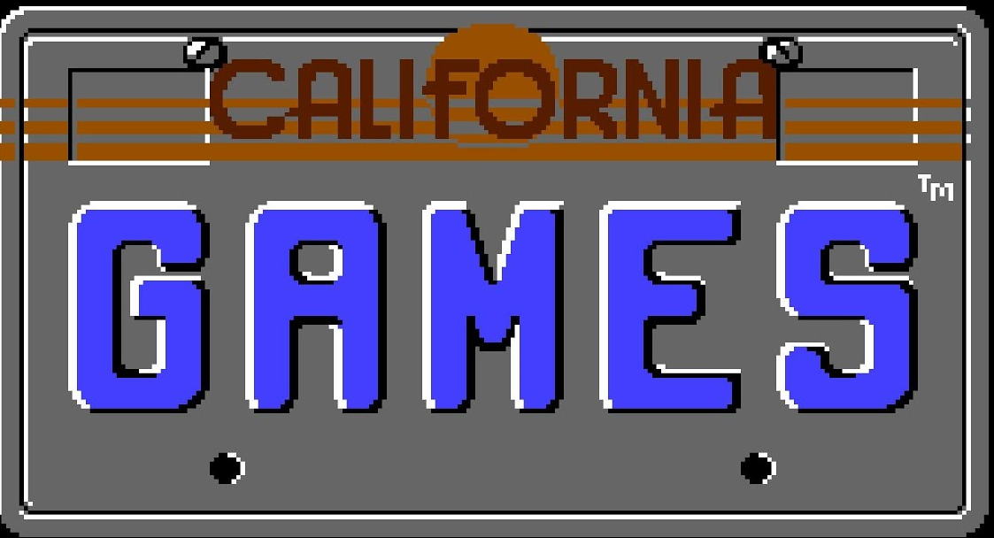
3D Digital Game Art
Practice Brief

Slide 2
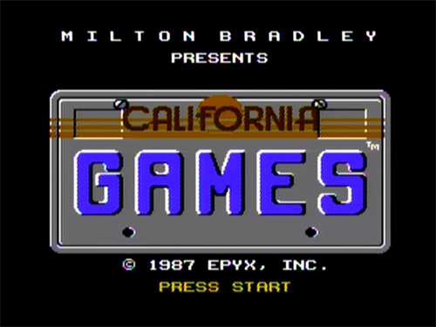
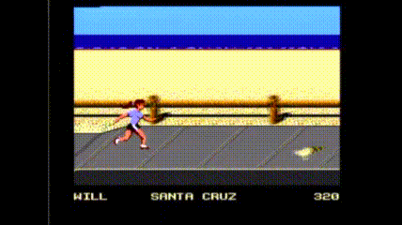
3D Digital Game Art
Practice Brief
Keep on Rollin’
Our latest client is wanting a remake of an 80’s classic ‘California Games’.
You have been tasked with creating assets for this game so players can customise their avatars.
So, they are in need of……

Slide 3
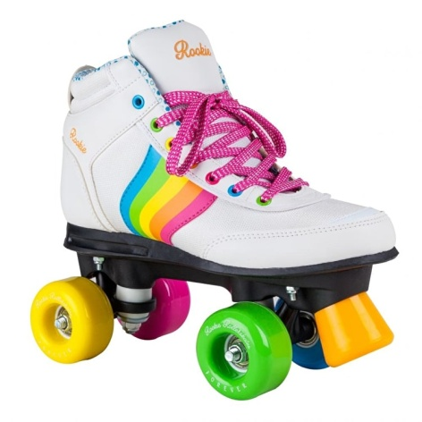
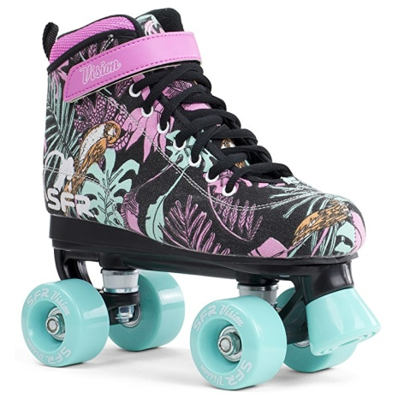
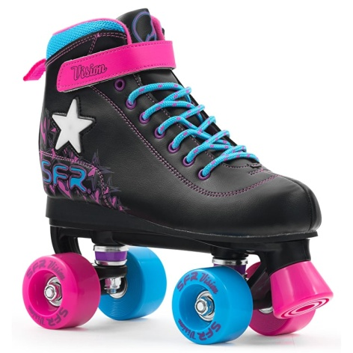
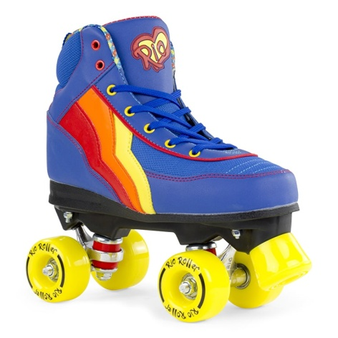
3D Digital Game Art
Practice Brief
Boots!
…Roller boots!
That’s right. We’re going to need some roller boot assets to go in our game.
And that’s where you come in.
We need you to model and texture a pair of roller boots. You’re free to create your own livery for your boots so be creative!

Slide 4
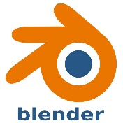
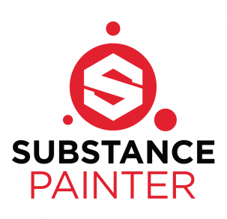
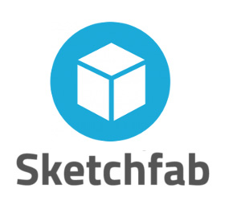
3D Digital Game Art
Practice Brief
The Asset Production Pipeline
When creating your boots, we need you to follow this production pipeline:
3D Modelling & Unwrap
Materials and Textures
Delivery
High Poly Mesh
Render High Poly Mesh to Low Poly Mesh
Upload to Sketchfab Website
Low Poly Mesh
Create Materials & Textures
Share link so we can view your work!
UV Unwrap of Low Poly Mesh

Slide 5
3D Digital Game Art
Practice Brief
The Asset Production Pipeline
Why do you need to follow this pipeline?
All 3D Digital Game Art competition briefs are written by 3D artists who work in the games industry. They know exactly what processes are needed to create great 3D art to a professional standard.
Following this correctly when creating your drone will demonstrate your understanding of the pipeline and that you are capable of competing in future 3D digital game art tasks.
To further prove your understanding, the judges will be marking your drone on the following criteria…

Slide 6
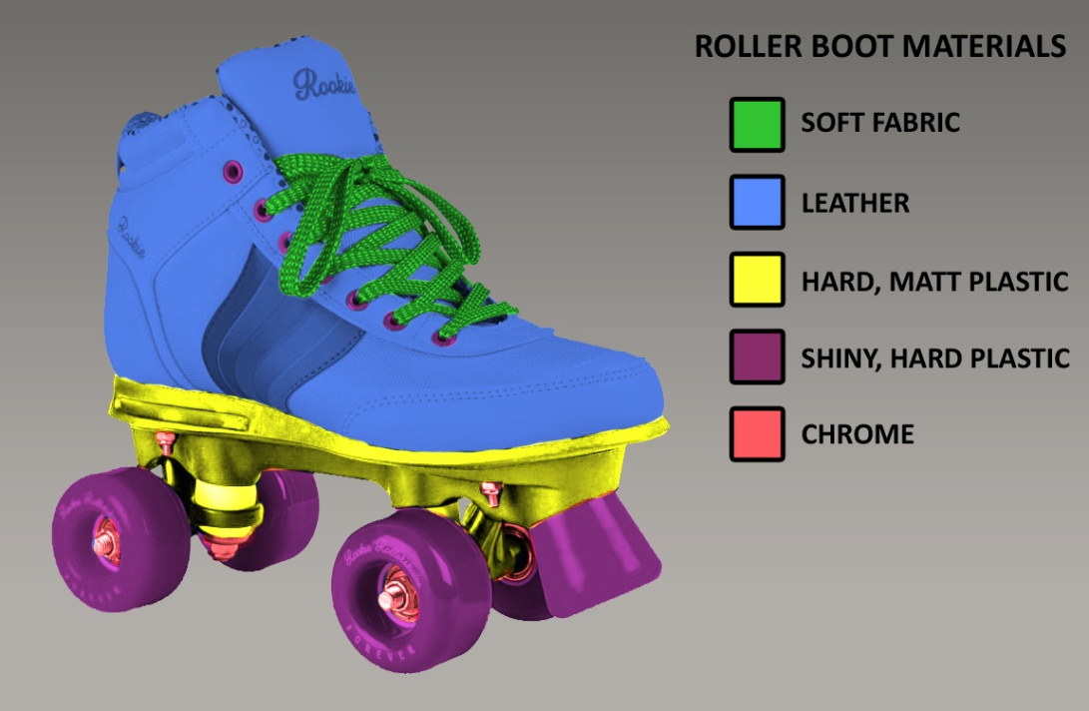
3D Digital Game Art
Practice Brief
Back to the Materials
Our roller boots need to look and feel like real roller boots.
To do that, we’ll create our materials using a PBR workflow. The same way you created your materials for your skateboard.
Only this time, you’ll be directed on what materials you need to create, and your materials will be marked individually.

Slide 7
3D Digital Game Art
Practice Brief
What you need to do
We need you to 3D Model, UV Unwrap and texture a pair of roller boot assets using a PBR material workflow.
Focus on material types is important – they need to react to light correctly and should appear to be what they represent. Leather is leather, plastic is plastic etc.
Your roller boot must contain the following materials:
Leather – for the boot itself
Soft fabric – for the laces
Hard, matt plastic – for the base of the boot
Hard, shiny plastic – for the wheels
Chrome – for the wheel frame & wheel nuts
You are encouraged to create your own livery for your boots (have fun!)
You would have 5 hours in total to complete this task during a live heat!
When you have finished your boots, export to Sketchfab and share with your tutor.

Slide 8
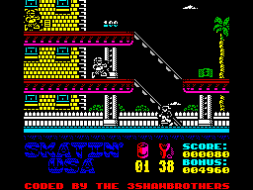
3D Digital Game Art
Practice Brief
What do you need…
You need the following to complete the task:
3DS Max, Maya or Blender
Substance Painter
Photoshop
Graphics tablet (optional)

Slide 9
3D Digital Game Art
Practice Brief
Technical Budgets
Triangle Count
Your roller boots must not exceed 10000 Triangles. – this is for both boots in total!
Texture Allowance
Your roller boots material must be made up of:
A single base colour or diffuse texture map
A single normal map
A single metallic map
A single roughness map.
The dimensions of these maps need to be 4096x4096.

Slide 10
3D Digital Game Art
Practice Brief
Marking Criteria
During a live heat, the judges would mark your work on the following:
3D Modelling
Models are within triangle budget – 10000 triangles
Triangle distribution and topology.
Asset silhouette.
Mesh tidiness.
UV Unwrapping
Demonstration of a UV unwrap.
Use of UV Space – mirrored or repeated.
Smooth and even UV shells.

Slide 11
3D Digital Game Art
Practice Brief
Marking Criteria
During a live heat, the judges would mark your work on the following:
Texturing & Materials
Texture resolutions are correct and on a single texture pages – 4096 x 4096
Textures appear seamless on model.
Representation of the following materials is accurate:
Leather
Soft Fabric
Hard, Matt Plastic
Hard, Shiny Plastic
Chrome
Delivery
Model is visible in Sketchfab export
Max, Maya or Blender scene tidiness
Substance file tidiness

Slide 12
3D Digital Game Art
Practice Brief
Some advice the Judges…
Read this brief again to be absolutely sure of what we’re looking for!
You have 5 hours to complete this task – plan your work carefully.
Save your work often!
DON’T stress it. This stuff is meant to be fun!
Consider the silhouette of your asset. Does it look like it should?
Be creative with your liveries! Again, have fun!
Check the material guide and make sure what you make looks correct – there’s lots of marks to be had here!
Consider the history behind your boots and the materials themselves:
Are they brand new or are they scuffed and worn?
Use the reference library – it's there to assist you!
Have fun! Set yourself a goal that you will enjoy working towards!

